Slide 1
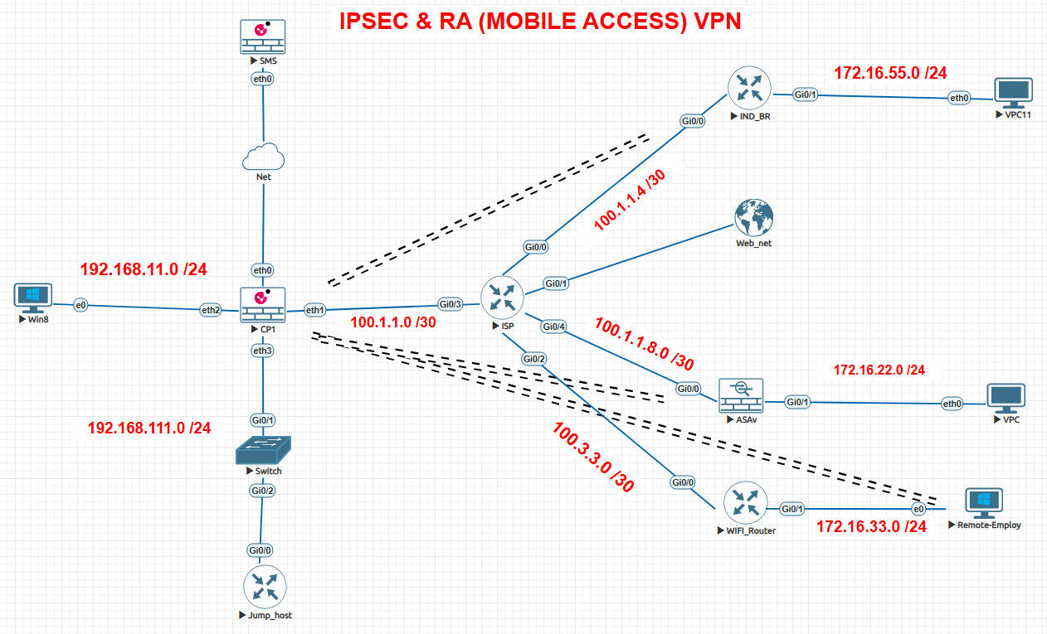
TOPOLOGY
Checkpoint: ASA: Router: INT - IP INT - IP INT - IP LAN - 192.168.11.254 INSIDE - 172.16.22.9 g0/1 - 172.16.55.5 WAN - 100.1.1.1 OUTSIDE - 100.1.1.9 g0/0 - 100.1.1.5
DMZ - 192.168.111.254
SA - (Security Association): a one-way (inbound or outbound) agreement between two communicating peers that specifies the IPsec protections to be provided to their communications. This includes the specific security protections, cryptographic algorithms, and secret keys to be applied, as well as the specific types of traffic to be protected.

Slide 2
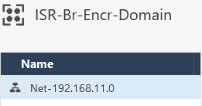
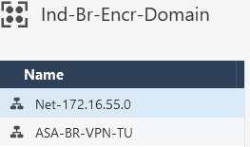
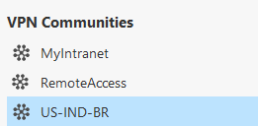
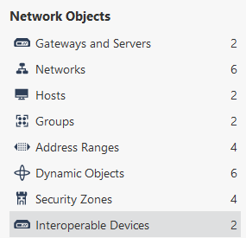



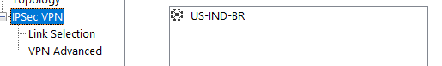
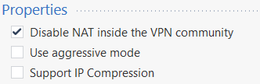
Checkpoint Configuration
1. Create Groups: IN 1st group, I have set 1 encryption domain. In 2nd group, I have set 2 encryption domains (Remote-Branch).
2. Create a VPN Community (Gateway, Encryption methods, Lifetime, Shared Secret)
3. Create an Interoperable Devices
i. Remote-public ip ii. Remote-Encryption domain
1

Slide 3
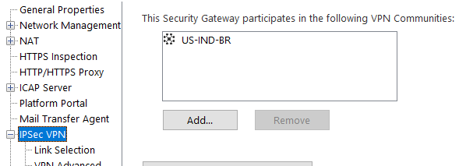
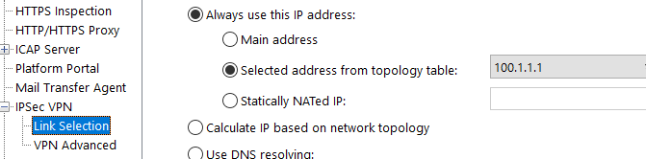
Checkpoint Configuration
4. Create a policy so that matched traffic go through tunnel
5. Define which public IP the gateway should use to send VPN traffic (by default, the gateway’s management interface IP is used).

Slide 4
ASA COFIGURATION
crypto ikev1 enable outside
crypto ikev1 policy 10 hash md5 authentication pre-share group 2
lifetime 86400 encryption des
tunnel-group 100.1.1.1 type ipsec-l2l
tunnel-group 100.1.1.1 ipsec-attributes
ikev1 pre-shared-key Shan_home-Car@1234334324
object network LOCAL-NET
subnet 172.16.22.0 255.255.255.0
object network REMOTE-NET
subnet 192.168.11.0 255.255.255.0
nat (inside,outside) source static LOCAL-NET LOCAL-NET destination static REMOTE-NET REMOTE-NET
access-list VPN-ACL extended permit ip 172.16.22.0 255.255.255.0 192.168.11.0 255.255.255.0
crypto ipsec ikev1 transform-set TSET esp-des esp-md5-hmac
crypto map CMAP 10 match address VPN-ACL
crypto map CMAP 10 set peer 100.1.1.1
crypto map CMAP 10 set ikev1 transform-set TSET
crypto map CMAP interface outside
route outside 0 0 100.1.1.10 1

Slide 5
IND-Router Configuration
crypto isakmp policy 10
authentication pre-share hash sha group 2 lifetime 86400 encryption aes
crypto isakmp key Shan_home-Car@5663355236 address 100.1.1.1
access-list 100 permit ip 172.16.55.0 0.0.0.255 192.168.11.0 0.0.0.255
crypto ipsec transform-set TR-SET esp-aes esp-sha-hmac
crypto map CMAP 10 policy ipsec-isakmp set peer 100.1.1.1 set transform-set TR-SET match address 100
int g0/0
crypto map CMAP
ip access-list extended dontFragment deny icmp any any fragement permit ip any any int g0/0 ip access-group dontFragment in

Slide 6
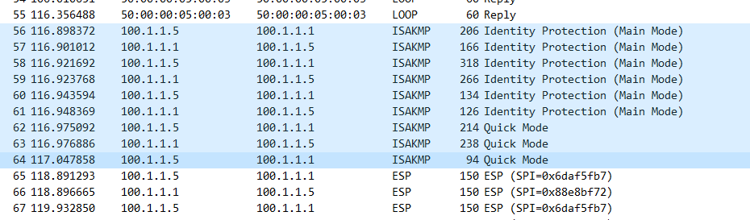
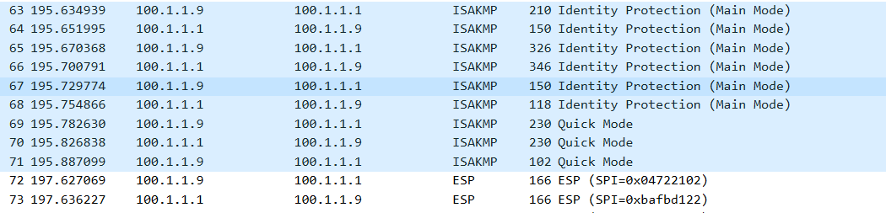
PING
ping from 172.16.55.1 to 192.168.11.11
ping from 172.16.22.1 to 192.168.11.11

Slide 7
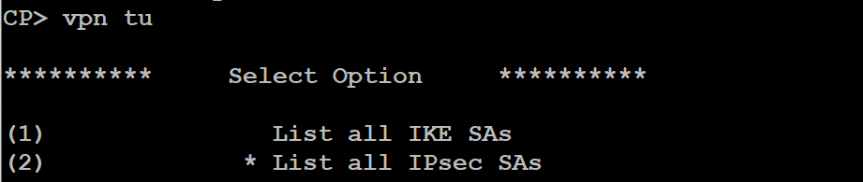
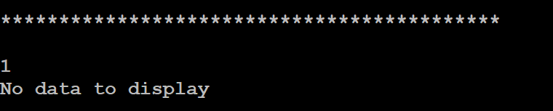
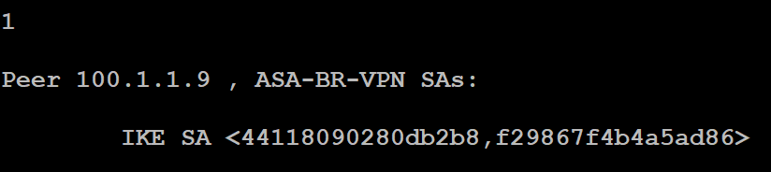
SITE-TO-SITE VPN (TROUBLESHOOT) On Checkpoint
1. SA MISAMTCH: Hagle Parameter Mismatch
H – Hash - md5, sha A – Authentication - G – DH Group – 2,5 …… L – Lifetime - <60-86400> seconds E – Encryption - des, 3des, aes, aes-gcm
2. MM_KEY_EXCH:
(specific: fw ctl zdebug drop + grep 100.1.1.9)
3. Phase 2 transform-set mismatch: (esp, ah)

Slide 8
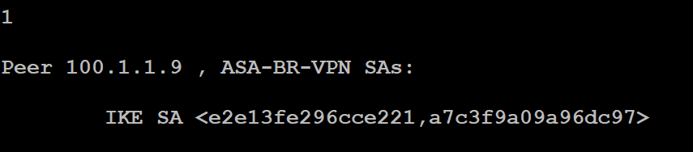
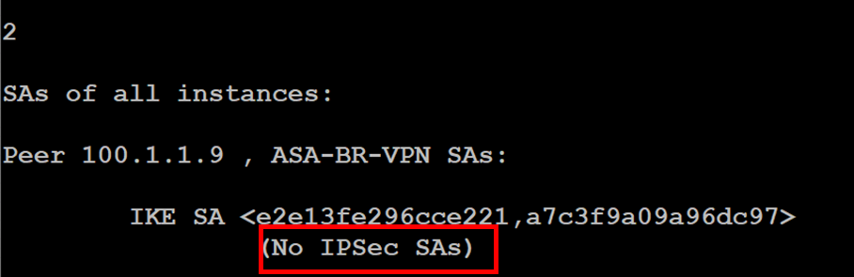
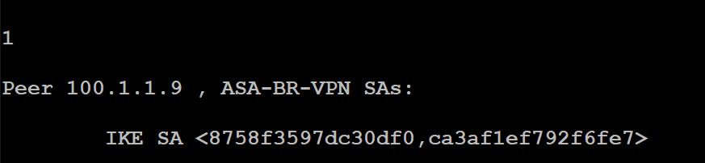
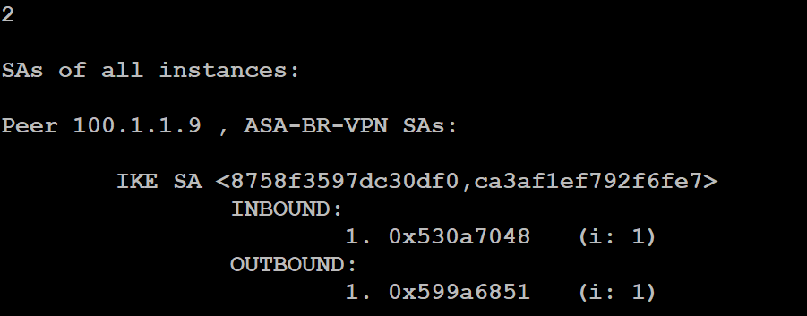
SITE-TO-SITE VPN (TROUBLESHOOT) On Checkpoint
4. No crypto acl or Encryption Domain otherside
4. Both phases success:
Once an IKE negotiation is successfully completed, the peers have established two pairs of one-way (inbound and outbound) SAs. Since IKE always negotiates pairs of SAs, the term "SA" is generally used to refer to a pair of SAs (e.g., an "IKE SA" or an "IPsec SA" is in reality a pair of one- way SAs).

Slide 9
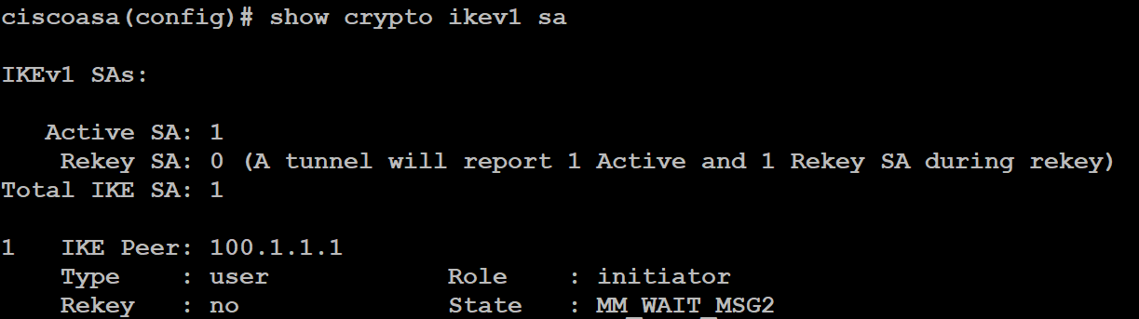
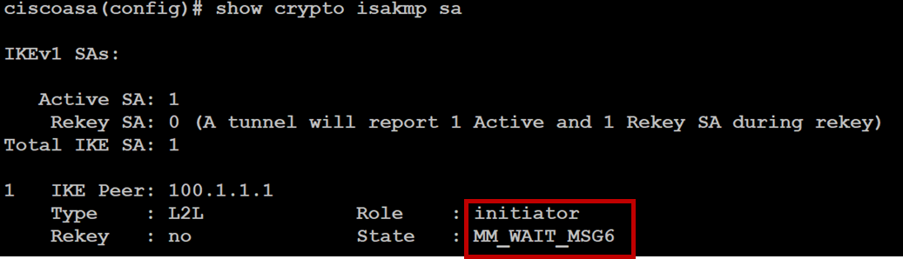
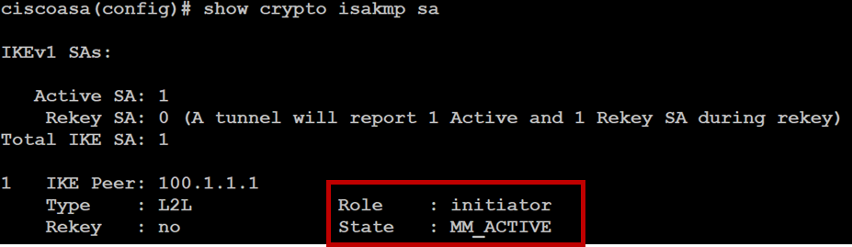

SITE-TO-SITE VPN (TROUBLESHOOT) On ASA
1. SA MISAMTCH:
2. MM_KEY_EXCH:
3. Phase 2 transform-set mismatch: (esp, ah)
Phase1 – UP Phase2 - Down

Slide 10
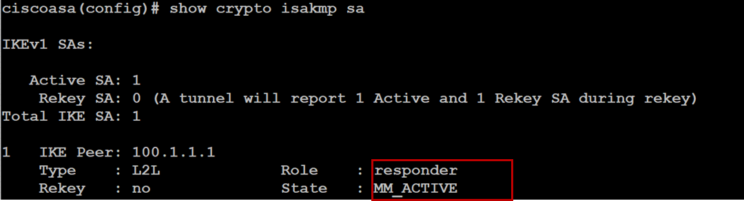
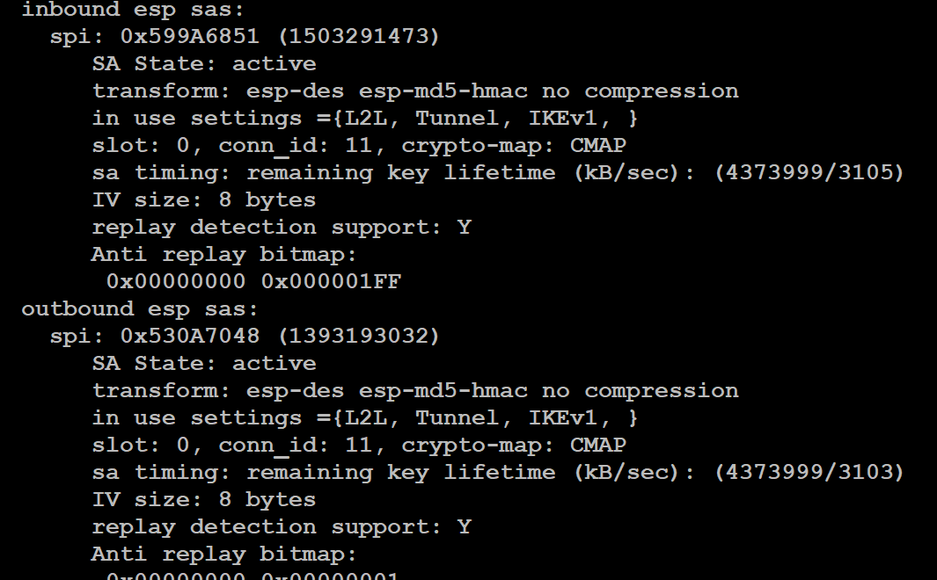
SITE-TO-SITE VPN (TROUBLESHOOT) On ASA
4. Both phases success:

Slide 11
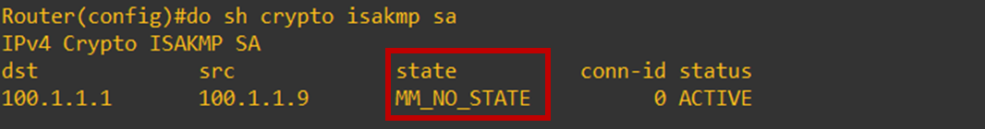
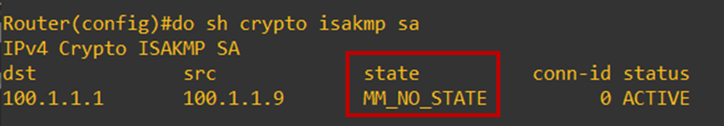
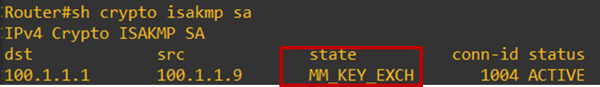
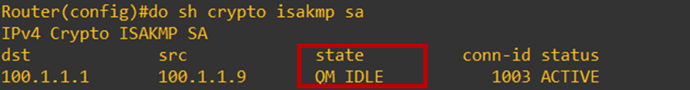
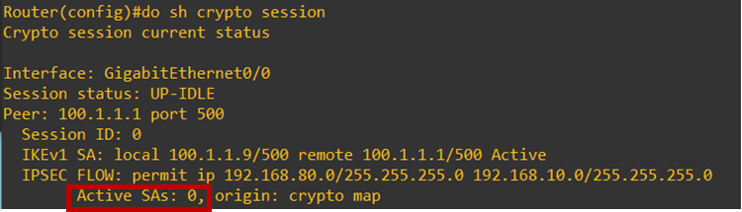
SITE-TO-SITE VPN (TROUBLESHOOT) On Router
1. SA MISAMTCH: Hagle Parameter Mismatch
2. If No crypto ACL on remote device only single message appears
2. MM_KEY_EXCH: Authentication key mismatch.
3. Phase 2 transform-set mismatch: (esp, ah)
(QM_IDLE - phase 1 tunnel is successfully established.)

Slide 12

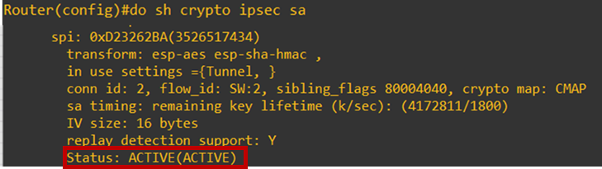
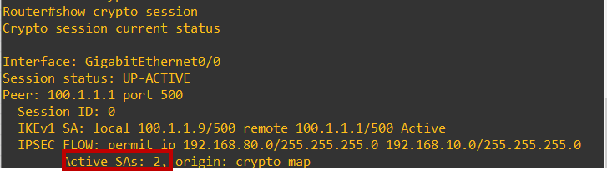
SITE-TO-SITE VPN (TROUBLESHOOT) On Router
4. Both phases success:

Slide 13
Other possible causes & Solution
Configuration need to check or perform:
DNS resolution check
MTU mismatch & Fragmentation (ping ip-address df-bit <size>, show ip traffic)
Asymmetric route (check using traceroute)
Device-health or CPU utilisation (show platform resources, show process cpu sorted)
Perform Quality Of service for TCP or interesting traffic
Firewall Policy (use inline and ordered layer policy as it provides hierarchical policy structure)
Use Policy trace (virtual check)

